Slide 1
Trees

Slide 2
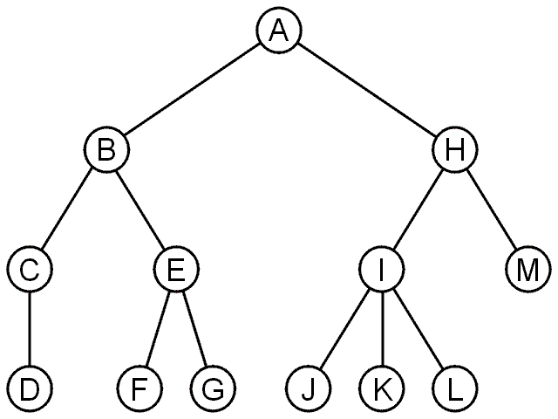
Trees
A tree data structure stores information in nodes
Similar to linked lists:
There is a first node, or root
Each node has variable number of references to successors
Each node, other than the root, has exactly one node pointing to it

Slide 3
Terminology
node: an object containing a data value and left/right children
root: topmost node of a tree
leaf: a node that has no children
branch: any internal node; neither the root nor a leaf
parent: a node that refers to this one
child: a node that this node refers to
sibling: a node with common parent
root
1
2
3
4
5
6
7

Slide 4
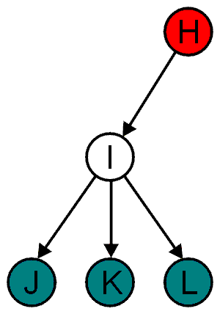
Terminology
All nodes will have zero or more child nodes or children
I has three children: J, K and L
For all nodes other than the root node, there is one parent node
H is the parent I

Slide 5
Terminology
The degree of a node is defined as the number of its children: deg(I) = 3
Nodes with the same parent are siblings
J, K, and L are siblings

Slide 6
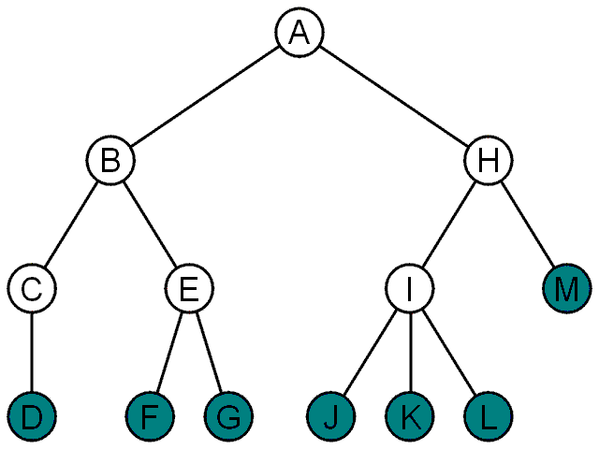
Terminology
Nodes with degree zero are also called leaf nodes
All other nodes are said to be internal nodes, that is, they are internal to the tree

Slide 7
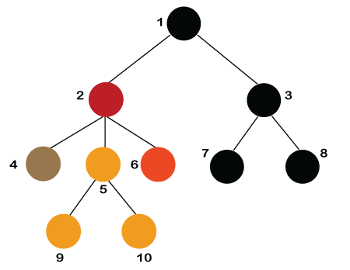
Properties
Recursive data structure: Recursion means reducing something in a self-similar manner.
Number of edges: If there are n nodes, then there would n-1 edges. Each arrow in the structure represents the link or path. Each node, except the root node, will have atleast one incoming link known as an edge. There would be one link for the parent-child relationship.
Depth of node x: The depth of node x can be defined as the length of the path from the root to the node x. One edge contributes one-unit length in the path. So, the depth of node x can also be defined as the number of edges between the root node and the node x. The root node has 0 depth.
Height of node x: The height of node x can be defined as the longest path from the node x to the leaf node.

Slide 8
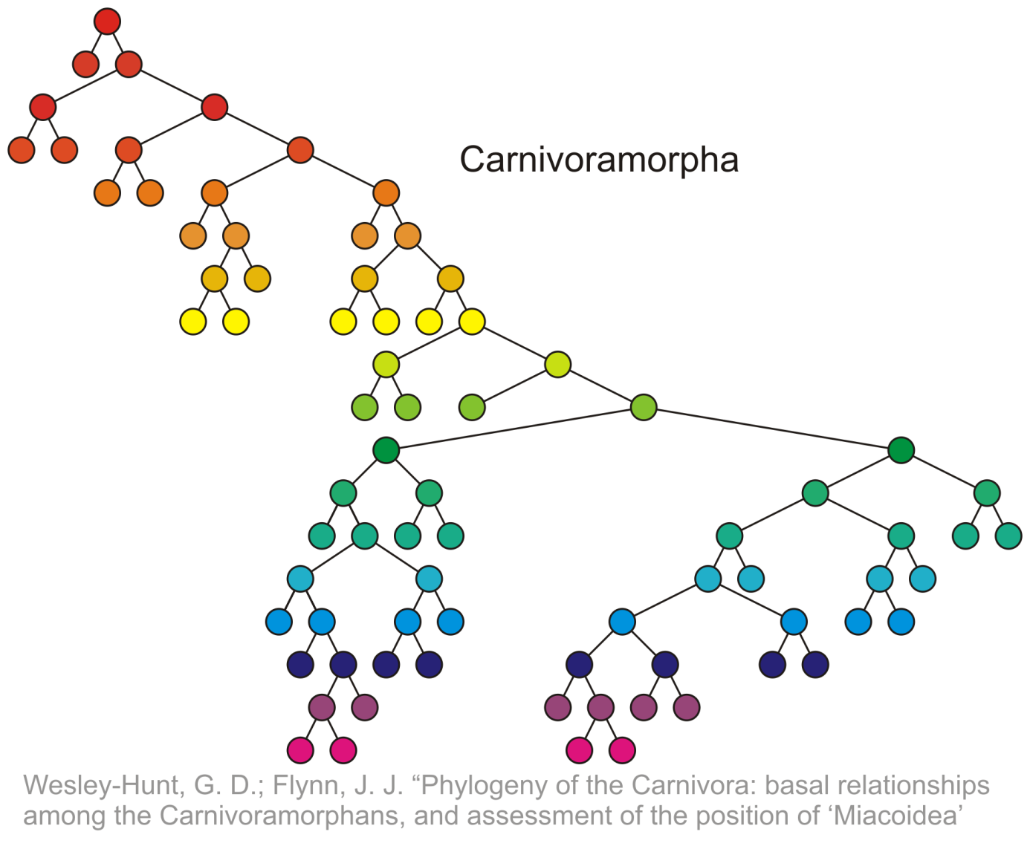
Height of tree
The height of this tree is 17
17

Slide 9
types
General tree
Binary tree
Binary Search tree
AVL tree
Red-Black Tree
Splay tree
Treap

Slide 10
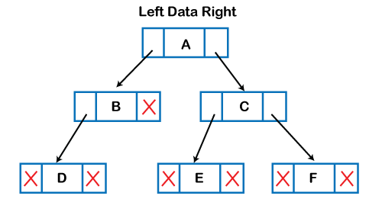
Binary tree
The above figure shows the representation of the tree data structure in the memory. In the above structure, the node contains three fields. The second field stores the data; the first field stores the address of the left child, and the third field stores the address of the right child.

Slide 11
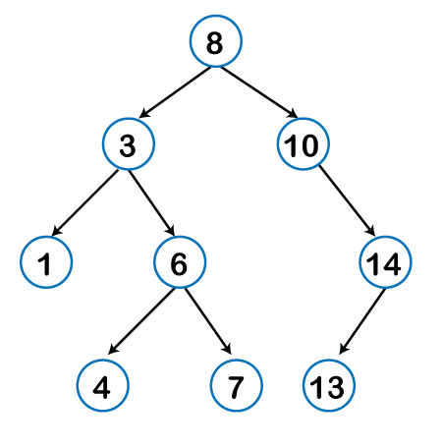
Binary Search tree

Slide 12
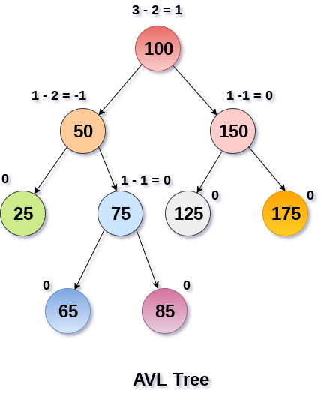
AVL tree
If balance factor of any node is 1, it means that the left sub-tree is one level higher than the right sub-tree.
If balance factor of any node is 0, it means that the left sub-tree and right sub-tree contain equal height.
If balance factor of any node is -1, it means that the left sub-tree is one level lower than the right sub-tree.

Slide 13
Questions?

